Slide 1


Linear Regression
05
PART II · LINEAR MODELS AND GENERALIZATION
CHAPTER 5 · WEEK 4
Machine Learning — From Hypotheses to Decisions
LECTURER
Dr. Mustafa Hameed
THE ISLAMIA UNIVERSITY OF BAHAWALPUR
Bahawalpur, Pakistan
Department of Information Technology · BSIT · Fall 2026
Notes:
Chapter 5: Linear Regression. Part 2 — Linear Models and Generalization. Week 4: Linear regression. Handout pages 38–44.

Slide 2

Where this chapter sits
THE COURSE
PART I
PART II
PART III
PART IV
PART V
PART VI
1
2
3
4
5
6
7
8
9
10
11
12
13
14
15
16
17
18
19
20
21
22
Linear Regression
BUILDS ON
USED LATER IN
Ch 2 Mathematics for Machine Learning
Ch 6 Logistic Regression
Ch 3 The Machine Learning Workflow and Toolkit
Ch 7 Overfitting, Bias–Variance and Regularisation
Ch 10 Bayesian Learning and Naive Bayes
Ch 12 Support Vector Machines
Ch 13 Artificial Neural Networks
Machine Learning · Chapter 5 · Linear Regression
Handout p. 38 2
Notes:
Place the chapter. Before you start: Chapter 2 (dot products, derivatives, gradient descent, maximum likelihood) and Chapter 3 (splits, scaling, baselines).

Slide 3

What you will be able to do
LEARNING OUTCOMES
By the end of this chapter you will be able to:
1
Write the linear regression model and its mean squared error loss, and interpret each weight.
2
Fit a simple linear regression by hand with the least-squares formulas, and state the normal equation for many features.
3
Derive the gradient descent update for linear regression and perform a step by hand.
4
Extend the model with multiple and polynomial features.
5
Evaluate a regression model with MAE, RMSE and R² against a baseline, and read a residual plot.
Machine Learning · Chapter 5 · Linear Regression
Handout p. 38 3
Notes:
Read these out: they are the chapter's contract with the room. Each click adds one.

Slide 4

Vocabulary for this chapter
KEY TERMS
regression
linear model
weight
bias (intercept)
residual
mean squared error
least squares
normal equation
batch, stochastic and mini-batch gradient descent
multiple regression
polynomial features
MAE
RMSE
R2
residual plot
Each term is defined where it first matters — not here.
Machine Learning · Chapter 5 · Linear Regression
Handout p. 38 4
Notes:
Do not define these now; they arrive one at a time. This slide is for the students' notes. Terms: regression; linear model; weight; bias (intercept); residual; mean squared error; least squares; normal equation; batch, stochastic and mini-batch gradient descent; multiple regression; polynomial features; MAE; RMSE; R2; residual plot.

Slide 5

In this chapter
IN THIS CHAPTER
5.1
The Model
p. 38 ›
5.2
The Loss: Mean Squared Error
p. 38 ›
5.3
Least Squares by Formula
p. 39 ›
5.4
Fitting by Gradient Descent
p. 40 ›
5.5
Multiple and Polynomial Features
p. 41 ›
5.6
Measuring a Regression Model
p. 41 ›
Machine Learning · Chapter 5 · Linear Regression
Handout pp. 38–44 5
Notes:
The route through the chapter. Each row is a link: click it to jump to that section in the slide show.

Slide 6

The Model
KEY IDEA
Linear regression predicts a number as a weighted sum of the features plus a constant:
With one feature this is the straight line ŷ = wx + b of school algebra. The weight w_{j} is the change in the prediction for a one-unit increase in feature j with the other features held fixed; the bias (or intercept) b is the prediction when every feature is zero.
Linear regression is the first model in the course because every later model either extends it (logistic regression, the perceptron, the SVM, a neural network’s output layer) or is compared against it. It is also, very often, the right answer: fast, stable, and explainable in one sentence per feature.
Machine Learning · Chapter 5 · Linear Regression
§5.1 · Handout p. 38 6
Notes:
Say this in your own words first; the slide is the handout's wording.

Slide 7
The Loss: Mean Squared Error
SECTION 2 OF 6
5.2
5.1 The Model
5.2 The Loss: Mean Squared Error
5.3 Least Squares by Formula
5.4 Fitting by Gradient Descent
5.5 Multiple and Polynomial Features
5.6 Measuring a Regression Model
Machine Learning · Chapter 5
Handout §5.2 7
Notes:
Pause. Name the question this section answers.

Slide 8

Residual and Mean Squared Error
DEFINITION
The residual of example i is e_{i} = y_{i} − ŷ_{i}, the vertical gap between the observed value and the prediction. The mean squared error of the model on n examples is
Fitting a linear regression means choosing w and b to make the MSE as small as possible — the method of least squares.
Machine Learning · Chapter 5 · Linear Regression
§5.2 · Handout p. 38 8
Notes:
Read the box aloud, then ask for an example from the room before moving on.

Slide 9
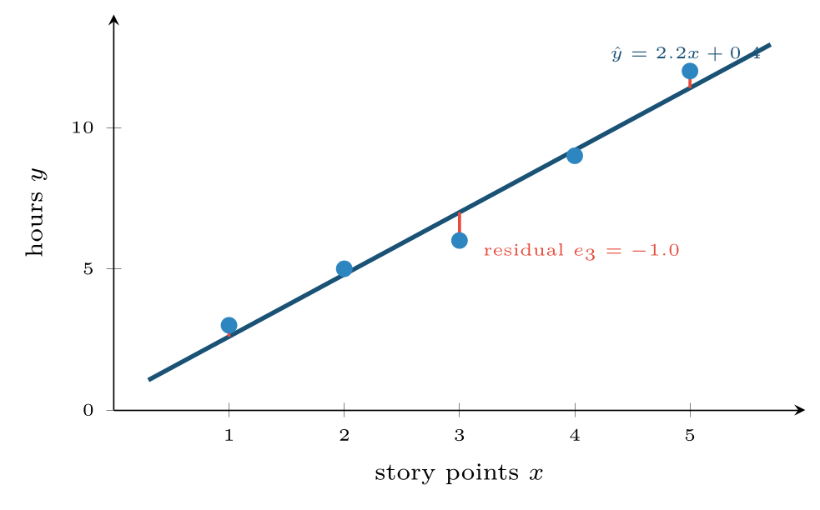
The least-squares line through five user stories
FIGURE 5.1
Each red segment is a residual; the line is the one that makes the sum of their squares smallest.
Machine Learning · Chapter 5 · Linear Regression
§5.2 · Handout p. 38 9
Notes:
Figure 5.1 (handout p. 39): The least-squares line through five user stories. Each red segment is a residual; the line is the one that makes the sum of their squares smallest.

Slide 10

Why Square the Residuals?
CONCEPT
Three reasons. Squaring makes every error positive, so over- and under-predictions cannot cancel. It makes the loss smooth, so it has a derivative everywhere and a single minimum that a formula can find. And it is what maximum likelihood gives (Chapter 2): if the noise around the true line is Gaussian, the most likely line is exactly the least-squares line. The price is that one large error counts a great deal — an error of 10 costs a hundred times an error of 1 — so least squares is pulled hard by outliers.
Machine Learning · Chapter 5 · Linear Regression
§5.2 · Handout p. 38 10
Notes:
Read the box aloud, then ask for an example from the room before moving on.

Slide 11
Least Squares by Formula
SECTION 3 OF 6
5.3
5.1 The Model
5.2 The Loss: Mean Squared Error
5.3 Least Squares by Formula
5.4 Fitting by Gradient Descent
5.5 Multiple and Polynomial Features
5.6 Measuring a Regression Model
Machine Learning · Chapter 5
Handout §5.3 11
Notes:
Pause. Name the question this section answers.

Slide 12
Least Squares by Formula
IN BRIEF
For one feature, setting the derivatives of the MSE with respect to w and b to zero gives a closed-form answer:
Machine Learning · Chapter 5 · Linear Regression
§5.3 · Handout p. 39 12
Notes:
For one feature, setting the derivatives of the MSE with respect to w and b to zero gives a closed-form answer:

Slide 13

Fitting Hours to Story Points
WORKED EXAMPLE
Five completed user stories: story points x = 1, 2, 3, 4, 5 took y = 3, 5, 6, 9, 12 hours.
Means: x̄ = 3, ȳ = 35/5 = 7.
Deviations: x − x̄ = −2, −1, 0, 1, 2 and y − ȳ = −4, −2, −1, 2, 5.
Slope:
Intercept: b = 7 − 2.2 × 3 = 0.4.
Reading it: each extra story point adds 2.2 hours; the intercept, 0.4 hours, is the fixed overhead of any story. A new 6-point story is predicted to take 2.2 × 6 + 0.4 = 13.6 hours.
Residuals: predictions 2.6, 4.8, 7.0, 9.2, 11.4 give residuals 0.4, 0.2, −1.0, −0.2, 0.6, which sum to zero — they always do for a least-squares line with an intercept. The sum of squares is 0.16 + 0.04 + 1 + 0.04 + 0.36 = 1.6, so MSE = 0.32.
Machine Learning · Chapter 5 · Linear Regression
§5.3 · Handout p. 39 13
Notes:
The line always passes through the point of means (x̄, ȳ).
Each click adds one step of the working. Ask for the next number before you reveal it.

Slide 14
The Normal Equation
DEFINITION
With d features, put a column of ones in front of X to absorb the bias, so the model is ŷ = Xθ. The least-squares parameters solve the normal equation
For the five stories,
whose solution is b = 0.4, w = 2.2 as before.
Machine Learning · Chapter 5 · Linear Regression
§5.3 · Handout p. 39 14
Notes:
Read the box aloud, then ask for an example from the room before moving on.

Slide 15
Fitting by Gradient Descent
SECTION 4 OF 6
5.4
5.1 The Model
5.2 The Loss: Mean Squared Error
5.3 Least Squares by Formula
5.4 Fitting by Gradient Descent
5.5 Multiple and Polynomial Features
5.6 Measuring a Regression Model
Machine Learning · Chapter 5
Handout §5.4 15
Notes:
Pause. Name the question this section answers.

Slide 16
Fitting by Gradient Descent
IN BRIEF
Differentiating the MSE with the chain rule gives the gradient:
Machine Learning · Chapter 5 · Linear Regression
§5.4 · Handout p. 40 16
Notes:
The normal equation is exact and needs no learning rate, but inverting a d × d matrix costs roughly d3 operations, and it fails outright when two features are perfect copies of each other (XX has no inverse). For many features, or data that does not fit in memory, gradient descent is used instead. Differentiating the MSE with the chain rule gives the gradient:

Slide 17
One Gradient Descent Step
WORKED EXAMPLE
Start from w = 0, b = 0 on the five stories, with α = 0.05. Every prediction is 0, so the errors ŷ − y are −3, −5, −6, −9, −12 and the MSE is (9 + 25 + 36 + 81 + 144)/5 = 59.
Update: w ← 0 − 0.05(−50.8) = 2.54, b ← 0 − 0.05(−14) = 0.70.
The new predictions 3.24, 5.78, 8.32, 10.86, 13.40 give an MSE of 2.29 — down from 59 in one step. Repeating the update converges to w = 2.2, b = 0.4, the same answer as the formula.
Machine Learning · Chapter 5 · Linear Regression
§5.4 · Handout p. 40 17
Notes:
Read it in words: each weight moves in proportion to the average of (error) × (its feature). A feature that is large exactly when the model under-predicts has its weight pushed up.
Each click adds one step of the working. Ask for the next number before you reveal it.

Slide 18

Fitting by Gradient Descent
AT A GLANCE
Variant | Each step uses | Trade-off
Batch | All n examples | Smooth, exact steps; slow when n is large
Stochastic (SGD) | One example, chosen at random | Very cheap steps; noisy path that jitters around the minimum
Mini-batch | A batch of, say, 32–256 examples | The practical default; what neural networks use (Chapter 13)
Machine Learning · Chapter 5 · Linear Regression
§5.4 · Handout p. 40 18
Notes:
Do not read the table row by row: pick the row the room is most likely to get wrong and ask why.

Slide 19

Scale the Features Before Gradient Descent
WATCH OUT
If one feature is measured in thousands and another in fractions, the MSE surface is a long narrow valley: a learning rate small enough for the steep direction crawls along the shallow one. Standardising the features (Chapter 3) makes the valley round and gradient descent converge in far fewer steps. The normal equation does not care.
Machine Learning · Chapter 5 · Linear Regression
§5.4 · Handout p. 40 19
Notes:
Read the box aloud, then ask for an example from the room before moving on.

Slide 20
Multiple and Polynomial Features
KEY IDEA
With several features each weight is a partial effect: the change in ŷ for one more unit of x_{j} with the other features held fixed. That is why the weight of a feature can change sign when another, correlated feature is added.
A linear model can also fit curves. Add powers of a feature as new features — x, x², x³ — and fit ŷ = w₁ x + w₂ x² + w₃ x³ + b. The model is still linear in the weights, so everything in this chapter applies unchanged; only the features are new. The danger is obvious as soon as it is said: with enough powers, the curve can pass through every training point. Chapter 7 begins exactly there.
Machine Learning · Chapter 5 · Linear Regression
§5.5 · Handout p. 41 20
Notes:
Say this in your own words first; the slide is the handout's wording.

Slide 21
Measuring a Regression Model
SECTION 6 OF 6
5.6
5.1 The Model
5.2 The Loss: Mean Squared Error
5.3 Least Squares by Formula
5.4 Fitting by Gradient Descent
5.5 Multiple and Polynomial Features
5.6 Measuring a Regression Model
Machine Learning · Chapter 5
Handout §5.6 21
Notes:
Pause. Name the question this section answers.

Slide 22
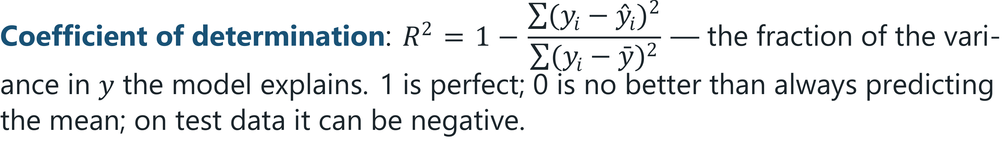
MAE, RMSE and R2
DEFINITION
Mean absolute error: MAE = 1/nΣ|y_{i} − ŷ_{i}| — the typical size of an error, in the units of y.
Root mean squared error: RMSE = √(MSE) — also in the units of y, but weighting large errors more.
Machine Learning · Chapter 5 · Linear Regression
§5.6 · Handout p. 41 22
Notes:
Read the box aloud, then ask for an example from the room before moving on.

Slide 23
Scoring the Story-Point Model
WORKED EXAMPLE
Residuals 0.4, 0.2, −1.0, −0.2, 0.6.
• MAE = (0.4 + 0.2 + 1.0 + 0.2 + 0.6)/5 = 0.48 hours.
• RMSE = √(1.6/5) = √(0.32) = 0.57 hours.
• Σ(y − ȳ)² = 16 + 4 + 1 + 4 + 25 = 50, so R² = 1 − 1.6/50 = 0.968.
Caution. These are training scores on five points fitted by two parameters. They say the line describes these five stories well. Whether it predicts the next story well can only be answered on stories it has not seen.
Machine Learning · Chapter 5 · Linear Regression
§5.6 · Handout p. 41 23
Notes:
Each click adds one step of the working. Ask for the next number before you reveal it.

Slide 24
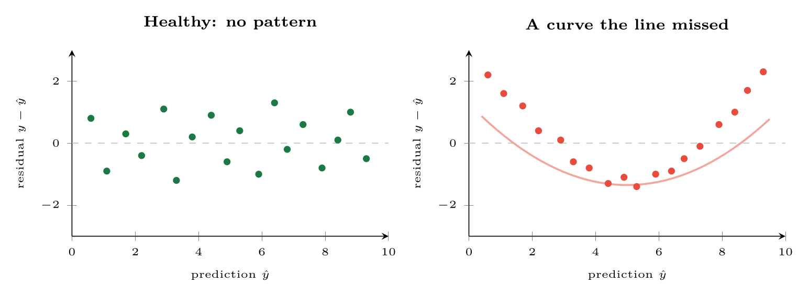
Residual plots
FIGURE 5.2
Left: residuals scattered evenly around zero, as they should be. Right: a U-shape, meaning the true relationship is curved; adding an x2 feature would remove it.
Machine Learning · Chapter 5 · Linear Regression
§5.6 · Handout p. 41 24
Notes:
Figure 5.2 (handout p. 42): Residual plots. Left: residuals scattered evenly around zero, as they should be. Right: a U-shape, meaning the true relationship is curved; adding an x2 feature would remove it.

Slide 25
Always Compare With the Mean
WATCH OUT
The baseline for regression is “predict the training mean for everyone”, which has R² = 0. On the diabetes data of this chapter’s lab it has an RMSE of 70; linear regression brings that to 56. Whether that improvement is worth having is a question about the application, not the algorithm — but without the baseline nobody could even ask it.
Machine Learning · Chapter 5 · Linear Regression
§5.6 · Handout p. 41 25
Notes:
Read the box aloud, then ask for an example from the room before moving on.

Slide 26

Common pitfalls
COMMON PITFALLS
✕
Reading a weight as a cause. w = 2.2 hours per point describes the data; it does not say that adding points to a story would add hours. Chapter 21 returns to this.
✕
Comparing raw weights across features. A weight’s size depends on its feature’s units. Standardise first, then compare.
✕
Extrapolating. The line was fitted on 1–5 points; a 40-point epic is outside anything it has seen.
✕
Ignoring the residual plot. A good R² with a curved residual pattern means a better model is available.
✕
Letting one outlier drive the fit. Squared loss gives a single wild point enormous influence. Look at the data first.
Machine Learning · Chapter 5 · Linear Regression
§5.6 · Handout p. 41 26
Notes:
For each pitfall, ask who has seen it happen. One real story beats five bullets.

Slide 27





Four lenses: Linear Regression
FOUR LENSES
LEARNING ANALYTICS
PROJECT MANAGEMENT
Predict a final mark from coursework.
Effort estimation is the textbook regression problem, and the story-point example is real practice.
INTERNET OF THINGS
CYBERSECURITY
Predict energy use from outdoor temperature and occupancy.
Predict normal outbound traffic per host from time of day and number of users, then treat a large positive residual as suspicious.
Machine Learning · Chapter 5 · Linear Regression
Handout p. 44 27
Notes:
The same method, four domains. Each of the next four slides opens one lens in full.

Slide 28

Learning Analytics: Linear Regression
FOUR LENSES
LEARNING ANALYTICS
Project Management
Predict a final mark from coursework. The weights are the attraction: “each extra lab submitted is worth 1.8 marks” is something an adviser can say to a student. The danger is reading it causally — students who submit labs differ in many ways from those who do not.
Internet of Things
Cybersecurity
Machine Learning · Chapter 5 · Linear Regression
Handout p. 44 28
Notes:
Learning Analytics. Predict a final mark from coursework. The weights are the attraction: “each extra lab submitted is worth 1.8 marks” is something an adviser can say to a student. The danger is reading it causally — students who submit labs differ in many ways from those who do not.

Slide 29

Project Management: Linear Regression
FOUR LENSES
PROJECT MANAGEMENT
Learning Analytics
Effort estimation is the textbook regression problem, and the story-point example is real practice. Report RMSE in hours, compare with “hours per point” from last quarter as the baseline, and refit every few sprints: teams change, and so does the slope.
Internet of Things
Cybersecurity
Machine Learning · Chapter 5 · Linear Regression
Handout p. 44 29
Notes:
Project Management. Effort estimation is the textbook regression problem, and the story-point example is real practice. Report RMSE in hours, compare with “hours per point” from last quarter as the baseline, and refit every few sprints: teams change, and so does the slope.

Slide 30

Internet of Things: Linear Regression
FOUR LENSES
INTERNET OF THINGS
Learning Analytics
Predict energy use from outdoor temperature and occupancy. The residual plot matters: consumption is U-shaped in temperature (heating when cold, cooling when hot), so a straight line leaves exactly the pattern of Figure 5.2; a squared temperature feature removes it.
Project Management
Cybersecurity
Machine Learning · Chapter 5 · Linear Regression
Handout p. 44 30
Notes:
Internet of Things. Predict energy use from outdoor temperature and occupancy. The residual plot matters: consumption is U-shaped in temperature (heating when cold, cooling when hot), so a straight line leaves exactly the pattern of Figure 5.2; a squared temperature feature removes it.

Slide 31

Cybersecurity: Linear Regression
FOUR LENSES
CYBERSECURITY
Learning Analytics
Predict normal outbound traffic per host from time of day and number of users, then treat a large positive residual as suspicious. The regression is not the detector; its residuals are. This is regression used for anomaly detection, and it works only if the training period was clean.
Project Management
Internet of Things
Machine Learning · Chapter 5 · Linear Regression
Handout p. 44 31
Notes:
Cybersecurity. Predict normal outbound traffic per host from time of day and number of users, then treat a large positive residual as suspicious. The regression is not the detector; its residuals are. This is regression used for anomaly detection, and it works only if the training period was clean.

Slide 32

Try it yourself: Least Squares Three Ways
TRY IT YOURSELF
The worked example by formula, then by gradient descent, then a real dataset: disease progression in 442 diabetes patients from ten measurements.
WHAT YOU WILL DO
1. The worked example, by formula
2. The same line by gradient descent
3. A real dataset, against the mean baseline
THIS WEEK'S LAB
WHAT YOU WILL RUN
RUNNABLE COPY
Week 4: Least squares three ways
1 listing, 37 lines of Python
code/ch05_least_squares_three.py
Machine Learning · Chapter 5 · Linear Regression
§5.6 · Handout p. 41 32
Notes:
The worked example by formula, then by gradient descent, then a real dataset: disease progression in 442 diabetes patients from ten measurements.

Slide 33
Least Squares Three Ways
LAB · STEP 1 OF 4
Set-up
Python · code/ch05_least_squares_three.py
2
3
4
5
6
7
import numpy as np
from sklearn.datasets import load_diabetes
from sklearn.model_selection import train_test_split
from sklearn.preprocessing import StandardScaler
from sklearn.linear_model import LinearRegression
from sklearn.metrics import mean_absolute_error, mean_squared_error, r2_score
Machine Learning · Chapter 5 · Linear Regression
§5.6 · Handout p. 41 33
Notes:
Step 1: Set-up. Read the code aloud; ask what each line would print before running it.

Slide 34
Least Squares Three Ways
LAB · STEP 2 OF 4
The worked example, by formula
Python · code/ch05_least_squares_three.py
9
10
11
12
13
14
# --- 1. the worked example, by formula -----------------------------------
x = np.array([1, 2, 3, 4, 5.0]) # story points
y = np.array([3, 5, 6, 9, 12.0]) # hours
w = ((x - x.mean()) * (y - y.mean())).sum() / ((x - x.mean()) ** 2).sum()
b = y.mean() - w * x.mean()
print(f"least squares: w = {w:.2f}, b = {b:.2f}")
Machine Learning · Chapter 5 · Linear Regression
§5.6 · Handout p. 41 34
Notes:
Step 2: The worked example, by formula. Read the code aloud; ask what each line would print before running it.

Slide 35
Least Squares Three Ways
LAB · STEP 3 OF 4
The same line by gradient descent
Python · code/ch05_least_squares_three.py
16
17
18
19
20
21
22
# --- 2. the same line by gradient descent --------------------------------
wg, bg, alpha = 0.0, 0.0, 0.05
for step in range(2000):
err = (wg * x + bg) - y # y_hat - y
wg -= alpha * 2 * (err * x).mean()
bg -= alpha * 2 * err.mean()
print(f"gradient descent: w = {wg:.2f}, b = {bg:.2f}")
Machine Learning · Chapter 5 · Linear Regression
§5.6 · Handout p. 41 35
Notes:
Step 3: The same line by gradient descent. Read the code aloud; ask what each line would print before running it.

Slide 36
Least Squares Three Ways
LAB · STEP 4 OF 4
A real dataset, against the mean baseline
Python · code/ch05_least_squares_three.py
24
25
26
27
28
29
30
31
32
33
34
35
36
37
38
# --- 3. a real dataset, against the mean baseline ------------------------
X, t = load_diabetes(return_X_y=True)
X_tr, X_te, t_tr, t_te = train_test_split(X, t, test_size=0.25,
random_state=0)
scaler = StandardScaler().fit(X_tr)
model = LinearRegression().fit(scaler.transform(X_tr), t_tr)
pred = model.predict(scaler.transform(X_te))
base = np.full_like(t_te, t_tr.mean()) # always predict the mean
for name, p in [("baseline (mean)", base), ("linear regression", pred)]:
print(f"{name:18s} MAE {mean_absolute_error(t_te, p):5.1f} "
f"RMSE {mean_squared_error(t_te, p) ** 0.5:5.1f} "
f"R2 {r2_score(t_te, p):5.2f}")
names = load_diabetes().feature_names
for i in np.argsort(-np.abs(model.coef_))[:3]:
print(f" weight on {names[i]:4s}: {float(model.coef_[i]):6.1f}")
Machine Learning · Chapter 5 · Linear Regression
§5.6 · Handout p. 41 36
Notes:
Step 4: A real dataset, against the mean baseline. Read the code aloud; ask what each line would print before running it.

Slide 37
What the lab shows
TRY IT YOURSELF
Change alpha to 0.2 in part 2 and run it again. Explain what you see using the worked example of Chapter 2.
Machine Learning · Chapter 5 · Linear Regression
§5.6 · Handout p. 41 37
Notes:
Read the box aloud, then ask for an example from the room before moving on.

Slide 38

Fit ŷ = wx + b to the points (0, 1), (1, 3), (2, 5) by the least-squares formulas.
CHECKPOINT 1 OF 3
Discuss with the person next to you, then advance.
Machine Learning · Chapter 5 · Linear Regression
Handout p. 44 · answers in Appendix D 38
Notes:
Ask the room. Do not advance until someone commits to an answer.

Slide 39

Fit ŷ = wx + b to the points (0, 1), (1, 3), (2, 5) by the least-squares formulas.
CHECKPOINT 1 OF 3 · ANSWER
x̄ = 1, ȳ = 3; w = ((−1)(−2) + 0 + (1)(2))/(1 + 0 + 1) = 2; b = 3 − 2 = 1. So ŷ = 2x + 1, which passes through all three points.
Machine Learning · Chapter 5 · Linear Regression
Handout p. 44 · answers in Appendix D 39
Notes:
Answer (Appendix D): x̄ = 1, ȳ = 3; w = ((−1)(−2) + 0 + (1)(2))/(1 + 0 + 1) = 2; b = 3 − 2 = 1. So ŷ = 2x + 1, which passes through all three points.

Slide 40
A model has R² = −0.2 on the test set. What does that mean?
CHECKPOINT 2 OF 3
Discuss with the person next to you, then advance.
Machine Learning · Chapter 5 · Linear Regression
Handout p. 44 · answers in Appendix D 40
Notes:
Ask the room. Do not advance until someone commits to an answer.

Slide 41
A model has R² = −0.2 on the test set. What does that mean?
CHECKPOINT 2 OF 3 · ANSWER
The model’s squared error on the test set is 20% larger than that of simply predicting the training mean: it is worse than the baseline.
Machine Learning · Chapter 5 · Linear Regression
Handout p. 44 · answers in Appendix D 41
Notes:
Answer (Appendix D): The model’s squared error on the test set is 20% larger than that of simply predicting the training mean: it is worse than the baseline.

Slide 42
Why is ŷ = w₁ x + w₂ x² + b still called a linear model?
CHECKPOINT 3 OF 3
Discuss with the person next to you, then advance.
Machine Learning · Chapter 5 · Linear Regression
Handout p. 44 · answers in Appendix D 42
Notes:
Ask the room. Do not advance until someone commits to an answer.

Slide 43
Why is ŷ = w₁ x + w₂ x² + b still called a linear model?
CHECKPOINT 3 OF 3 · ANSWER
Because ŷ is a weighted sum of its features — here x and x² — so it is linear in the weights, and least squares applies unchanged.
Machine Learning · Chapter 5 · Linear Regression
Handout p. 44 · answers in Appendix D 43
Notes:
Answer (Appendix D): Because ŷ is a weighted sum of its features — here x and x2 — so it is linear in the weights, and least squares applies unchanged.

Slide 44

What to take away
CHAPTER SUMMARY
1
Linear regression predicts ŷ = w·x + b; each weight is the effect of one more unit of its feature, others held fixed.
2
Least squares minimises the mean squared error; it is the maximum likelihood fit under Gaussian noise, and it is sensitive to outliers.
3
One feature: w = Σ(x−x̄)(y−ȳ) / Σ(x−x̄)², b = ȳ − wx̄. Many: the normal equation.
4
Gradient descent moves each weight by the average of error times feature; scale features first. Mini-batch is the practical default.
5
Polynomial features let a linear model fit curves — and overfit.
6
Report MAE or RMSE in the units of y, and R², beside the mean baseline; check the residual plot for patterns.
Machine Learning · Chapter 5 · Linear Regression
Handout p. 44 44
Notes:
Ask the room to say each takeaway before you reveal it.

Slide 45

Quick check 1 of 3
REVIEW · MULTIPLE CHOICE
The least-squares line always passes through:
A
the origin
B
(x̄, ȳ)
C
the first data point
D
the largest residual
Machine Learning · Chapter 5 · Linear Regression
Handout p. 44 45
Notes:
Take a show of hands for each option before discussing. (The handout does not print MCQ answers.)

Slide 46
Quick check 2 of 3
REVIEW · MULTIPLE CHOICE
Which metric is most affected by one very large error?
A
MAE
B
RMSE
C
the median absolute error
D
all equally
Machine Learning · Chapter 5 · Linear Regression
Handout p. 44 46
Notes:
Take a show of hands for each option before discussing. (The handout does not print MCQ answers.)

Slide 47
Quick check 3 of 3
REVIEW · MULTIPLE CHOICE
R² = 0 means the model:
does no better than predicting the mean
A
is perfect
B
C
has no bias
D
is overfitted
Machine Learning · Chapter 5 · Linear Regression
Handout p. 44 47
Notes:
Take a show of hands for each option before discussing. (The handout does not print MCQ answers.)

Slide 48
For your notebook
REVIEW QUESTIONS
SHORT
Explain in words the gradient of the MSE with respect to one weight.
SHORT
Give two situations where you would use gradient descent rather than the normal equation.
SHORT
Why can the weight of a feature change sign when another feature is added to the model?
APPLIED
For the points (1, 2), (2, 2), (3, 5), (4, 6), compute the least-squares line, the residuals, the MAE, the RMSE and R².
APPLIED
Starting from w = 0, b = 0 with α = 0.1, perform one gradient descent step on the data of the previous question and compute the MSE before and after.
Machine Learning · Chapter 5 · Linear Regression
Handout p. 44 48
Notes:
Set these for independent study. Model answers are not printed in the handout.

Slide 49
End of Chapter 5
05
NEXT
READ
Chapter 6 — Logistic Regression
Handout Chapter 5, pages 38–44
THIS WEEK'S LAB
Least squares three ways
Machine Learning · Chapter 5 · Linear Regression
49
Notes:
Close. NEXT: Chapter 6 — Logistic Regression. READ: Handout Chapter 5, pages 38–44. THIS WEEK'S LAB: Least squares three ways.

